Slide 1
INTRODUCTION TO MARKETING
0
Chapter 3
The Cultural
Environment
NGUYEN THI PHUONG*
THANG LONG UNIVERSITY
*MA in Global Marketing, PHD in Economics

Slide 2
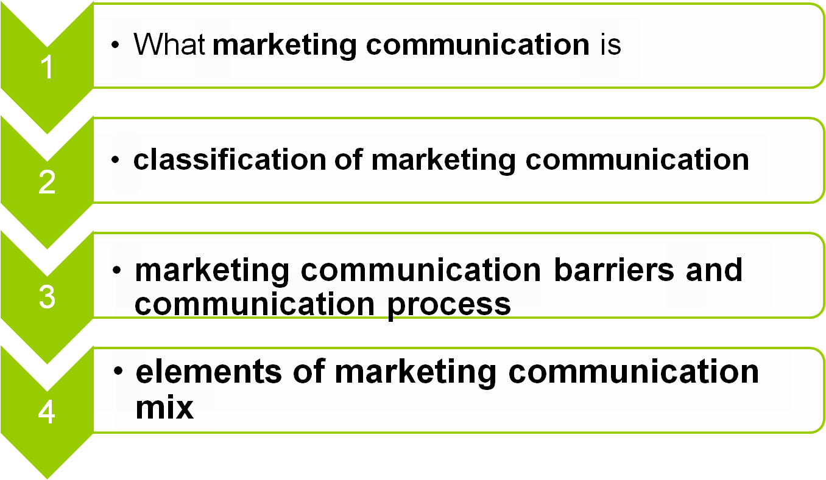
SESSION 12: Communication
Copyright © 2011 Pearson Education
15-<number>

Slide 3
12.1 Marketing communication overview
Communication can be defined as process of using, word, sound or visual cues-dấu hiệu thị giác to supply information to one or more people
Communication is one important aspect of the marketing mix. Marketing communication is often the largest component of communication within a company
Marketing communication presents company value, objectives or specific products and services to investors, customers or the general public
Copyright © 2011 Pearson Education
15-<number>

Slide 4
Marketing communication can be described as all the messages and media you deploy to communicate with the market
Marketing communication includes advertising, direct marketing, branding, packaging, your online presence, printed materials, PR activities, sales presentations, sponsorships, trade show appearance, etc
Advertising is only a small section of marketing communications and is not an alternative term to it
Copyright © 2011 Pearson Education
15-<number>

Slide 5
Marketing communication has two objectives.
create and sustain demand and preference for the product: aims at using communication tools to help position your product or company (building a brand) in the minds of the target customer
shorten the sales cycle.
Copyright © 2011 Pearson Education
15-<number>

Slide 6
12.2 Five factors of communication
persuasion and information: persuade their target audience to change their attitudes and behavior
objectives: creating brand awareness, delivering information, educating the market and an advanced positive image
contact points (điểm tiếp xúc): managing and coordinating a marketing message
stakeholders: anyone in the target market that can influence the purchase of the product
marketing communication activities: advertising, sales promotion, public relations, direct marketing, personal selling, point of purchase, etc.
Copyright © 2011 Pearson Education
15-<number>

Slide 7
12.3 Communication barriers
Communication barriers are factors that hinder the effectiveness of a marketing communication.
Major communication barriers:
Noise and clutter (lộn xộn)
consumer apathy (thờ ơ)
brand parity: the similarity of one brand to another
weak creative ideas or strategies.
Copyright © 2011 Pearson Education
15-<number>

Slide 8
Communication barriers
Noise is an unrelated sensory stimulus that distracts a consumer from the marketing message
Clutter is the high number and concentration of advertisements presented to a consumer at any time.
Consumer apathy is the tendency of a consumer to avoid marketing communications
Brand parity means a brand is not significantly different from its competition
Weak creative ideas or strategies: not allow the brand to be positioned separate from its competition.
Copyright © 2011 Pearson Education
15-<number>

Slide 9
Communication process
Source: individual or organization that has information to share
Encoding: This is transposing the intended meaning of the message with words, symbols or pictures to show a message.
Message: comes from the encoding process; it is the content, meaning or information the sources hope to convey (verbal, non-verbal, oral, written or symbolic)
  Decoding: process of interpreting messages. The receiver transforming the sender's message back into thought.
Copyright © 2011 Pearson Education
15-<number>

Slide 10
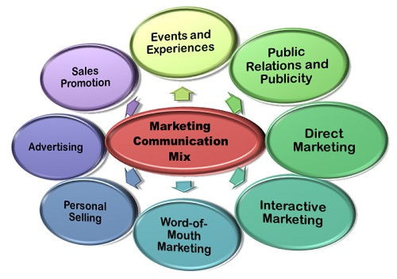
12.4 Marketing communication mix
Marketing Communication mix refers to the different tools that a firm can adopt to inform, persuade, and remind the customer about the product and services it sells
Copyright © 2011 Pearson Education
15-<number>

Slide 11
Advertising: an indirect, paid method used by the firms to inform the customers about their goods and services via television, radio, print media, online websites
Sales Promotion: includes the several short-term incentives to persuade the customers to initiate the purchase of the goods and services
Events and Experiences: sponsor the events such as sports, entertainment, nonprofit or community events with the intention to reinforce their brand
Copyright © 2011 Pearson Education
15-<number>

Slide 12
Public Relations and Publicity (công khai): The companies perform several social activities with a view to creating their positive brand image in the market
Direct Marketing: make use of emails, fax, mobile phones, to communicate directly with customers without involving any third party in between.
Interactive Marketing: a marketing communication tool, wherein the customers can interact with the firms online and can get their queries resolved online (Amazon, answer.com)
Copyright © 2011 Pearson Education
15-<number>

Slide 13
Word-of- Mouth Marketing: customer share their experiences with their peers and friends about the goods and services they bought recently.
Personal Selling: salesmen approach the prospective customers directly and inform them about the goods and services they are dealing in.
Copyright © 2011 Pearson Education
15-<number>

Slide 14
Homework
1. Give some examples of companies using elements of marketing communication mix
Copyright © 2011 Pearson Education
15-<number>

